Slide 1
RUSTikales Rust for beginners
©Philippe Felix Haupt 2023

Slide 2
Plan for today
©Philippe Felix Haupt 2023

Slide 3
Plan for today
Recap
©Philippe Felix Haupt 2023

Slide 4
Plan for today
Recap
Revisiting References
©Philippe Felix Haupt 2023

Slide 5
Plan for today
Recap
Revisiting References
Lifetimes
©Philippe Felix Haupt 2023

Slide 6
Plan for today
Recap
Revisiting References
Lifetimes
Functions
©Philippe Felix Haupt 2023

Slide 7
Plan for today
Recap
Revisiting References
Lifetimes
Functions
Basics
©Philippe Felix Haupt 2023

Slide 8
Plan for today
Recap
Revisiting References
Lifetimes
Functions
Basics
Components
©Philippe Felix Haupt 2023

Slide 9
Recap
©Philippe Felix Haupt 2023

Slide 10
Recap
Primitive Types in Rust: i8, u8, …, i128, u128, bool
©Philippe Felix Haupt 2023

Slide 11
Recap
Primitive Types in Rust: i8, u8, …, i128, u128, bool
`var[index]` to access an element of a Vector or Array
zero-indexed
©Philippe Felix Haupt 2023

Slide 12
Recap
Primitive Types in Rust: i8, u8, …, i128, u128, bool
`var[index]` to access an element of a Vector or Array
zero-indexed
loop { } creates an infinite loop
while condition { } creates a conditional loop
for elem in collection { } iterates over a collection
©Philippe Felix Haupt 2023

Slide 13
Recap
Primitive Types in Rust: i8, u8, …, i128, u128, bool
`var[index]` to access an element of a Vector or Array
zero-indexed
loop { } creates an infinite loop
while condition { } creates a conditional loop
for elem in collection { } iterates over a collection
Ownership-Model
Every variable, every value, everything in Rust has exactly one owner
Stuff is freed (no longer usable) when the owner is freed
Ownership-Conflicts are resolved by moving ownership
©Philippe Felix Haupt 2023

Slide 14
Recap
Primitive Types in Rust: i8, u8, …, i128, u128, bool
`var[index]` to access an element of a Vector or Array
zero-indexed
loop { } creates an infinite loop
while condition { } creates a conditional loop
for elem in collection { } iterates over a collection
Ownership-Model
Every variable, every value, everything in Rust has exactly one owner
Stuff is freed (no longer usable) when the owner is freed
Ownership-Conflicts are resolved by moving ownership
Borrowing
Way of not moving or copying data when it’s not needed
References
©Philippe Felix Haupt 2023

Slide 15
Recap
Primitive Types in Rust: i8, u8, …, i128, u128, bool
`var[index]` to access an element of a Vector or Array
zero-indexed
loop { } creates an infinite loop
while condition { } creates a conditional loop
for elem in collection { } iterates over a collection
Ownership-Model
Every variable, every value, everything in Rust has exactly one owner
Stuff is freed (no longer usable) when the owner is freed
Ownership-Conflicts are resolved by moving ownership
Borrowing
Way of not moving or copying data when it’s not needed
References
Borrow Checker
0 mutable references to a variable → infinite immutable references allowed
1 mutable reference to a variable → zero immutable references allowed
>1 mutable reference to a variable ← forbidden
©Philippe Felix Haupt 2023

Slide 16
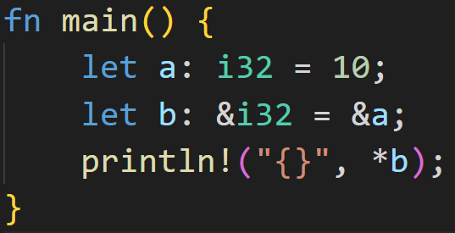
Recap
©Philippe Felix Haupt 2023

Slide 17
Recap
immutable borrow
©Philippe Felix Haupt 2023

Slide 18
Recap
immutable borrow
dereference (gain access to original variable) using the *
©Philippe Felix Haupt 2023

Slide 19
Recap
immutable borrow
dereference (gain access to original variable) using the *
a: i32 | 10
©Philippe Felix Haupt 2023

Slide 20
Recap
immutable borrow
dereference (gain access to original variable) using the *
b: &i32 | ptr
a: i32 | 10
©Philippe Felix Haupt 2023

Slide 21
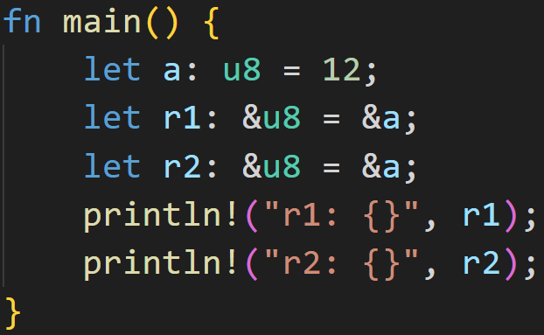
Recap
©Philippe Felix Haupt 2023

Slide 22
Recap
immutable borrow
immutable borrow
©Philippe Felix Haupt 2023

Slide 23
Recap
immutable borrow
immutable borrow
implicit deref
implicit deref
©Philippe Felix Haupt 2023

Slide 24
Recap
a: u8 | 12
©Philippe Felix Haupt 2023

Slide 25
Recap
r1: &u8 | ptr
a: u8 | 12
r2: &u8 | ptr
©Philippe Felix Haupt 2023

Slide 26
Recap
We’re borrowing, no ownership violation! When r1 and r2 are freed, they only free the pointer, not the variable it points to
r1: &u8 | ptr
a: u8 | 12
r2: &u8 | ptr
©Philippe Felix Haupt 2023

Slide 27
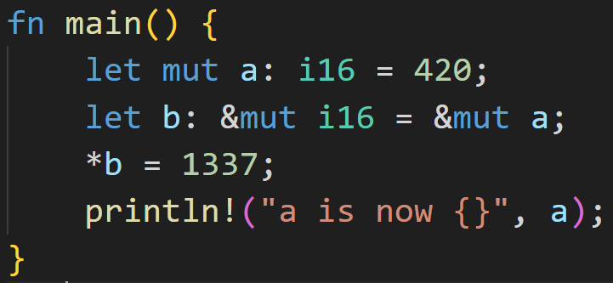
Recap
©Philippe Felix Haupt 2023

Slide 28
Recap
mutable borrow only possible when variable itself is mutable
mutable borrow
©Philippe Felix Haupt 2023

Slide 29
Recap
mutable borrow only possible when variable itself is mutable
mutable borrow
a: mut i16 | 420
©Philippe Felix Haupt 2023

Slide 30
Recap
mutable borrow only possible when variable itself is mutable
mutable borrow
b: &mut i16 | ptr
a: mut i16 | 420
©Philippe Felix Haupt 2023

Slide 31
Recap
Dereferences b, and sets the original variable to 1337
b: &mut i16 | ptr
a: mut i16 | 420
©Philippe Felix Haupt 2023

Slide 32
Recap
Dereferences b, and sets the original variable to 1337
b: &mut i16 | ptr
a: mut i16 | 420
a == *b
*b: mut i16 | 420
©Philippe Felix Haupt 2023

Slide 33
Recap
Dereferences b, and sets the original variable to 1337
b: &mut i16 | ptr
a: mut i16 | 1337
a == *b
*b: mut i16 | 1337
©Philippe Felix Haupt 2023

Slide 34
Lifetimes
©Philippe Felix Haupt 2023

Slide 35
Lifetimes
As we’ve seen last time, we’re allowed to mutably borrow variables as many times as we want, what’s up with that?
©Philippe Felix Haupt 2023

Slide 36
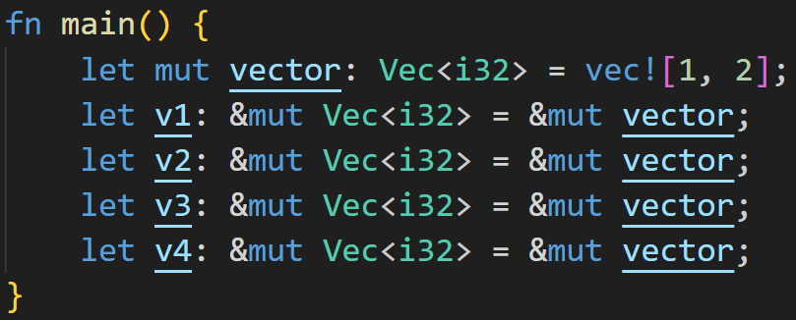
Lifetimes
As we’ve seen last time, we’re allowed to mutably borrow variables as many times as we want, what’s up with that?
©Philippe Felix Haupt 2023

Slide 37
Lifetimes
As we’ve seen last time, we’re allowed to mutably borrow variables as many times as we want, what’s up with that?
mutable borrow!
mutable borrow!
mutable borrow!
mutable borrow!
©Philippe Felix Haupt 2023

Slide 38
Lifetimes
As we’ve seen last time, we’re allowed to mutably borrow variables as many times as we want, what’s up with that?
mutable borrow!
mutable borrow!
mutable borrow!
mutable borrow!
Yet, this compiles just fine! How?
©Philippe Felix Haupt 2023

Slide 39
Lifetimes
As we’ve seen last time, we’re allowed to mutably borrow variables as many times as we want, what’s up with that?
To explain this, we need to introduce Lifetimes
©Philippe Felix Haupt 2023

Slide 40
Lifetimes
As we’ve seen last time, we’re allowed to mutably borrow variables as many times as we want, what’s up with that?
To explain this, we need to introduce Lifetimes
Every variable in Rust has a Lifetime:
©Philippe Felix Haupt 2023

Slide 41
Lifetimes
As we’ve seen last time, we’re allowed to mutably borrow variables as many times as we want, what’s up with that?
To explain this, we need to introduce Lifetimes
Every variable in Rust has a Lifetime:
“A lifetime is a construct of the compiler (or more specifically, its borrow checker) uses to ensure all borrows are valid. Specifically, a variable's lifetime begins when it is created and ends when it is destroyed.” - Rust Docs
©Philippe Felix Haupt 2023

Slide 42
Lifetimes
As we’ve seen last time, we’re allowed to mutably borrow variables as many times as we want, what’s up with that?
To explain this, we need to introduce Lifetimes
Every variable in Rust has a Lifetime:
“A lifetime is a construct of the compiler (or more specifically, its borrow checker) uses to ensure all borrows are valid. Specifically, a variable's lifetime begins when it is created and ends when it is destroyed.” - Rust Docs
This is where things get tricky, and very complicated
For a very long time, the following definitions will suffice:
©Philippe Felix Haupt 2023

Slide 43
Lifetimes
As we’ve seen last time, we’re allowed to mutably borrow variables as many times as we want, what’s up with that?
To explain this, we need to introduce Lifetimes
Every variable in Rust has a Lifetime:
“A lifetime is a construct of the compiler (or more specifically, its borrow checker) uses to ensure all borrows are valid. Specifically, a variable's lifetime begins when it is created and ends when it is destroyed.” - Rust Docs
This is where things get tricky, and very complicated
For a very long time, the following definitions will suffice:
Lifetime for a variable: Usually the code block it is defined in
©Philippe Felix Haupt 2023

Slide 44
Lifetimes
As we’ve seen last time, we’re allowed to mutably borrow variables as many times as we want, what’s up with that?
To explain this, we need to introduce Lifetimes
Every variable in Rust has a Lifetime:
“A lifetime is a construct of the compiler (or more specifically, its borrow checker) uses to ensure all borrows are valid. Specifically, a variable's lifetime begins when it is created and ends when it is destroyed.” - Rust Docs
This is where things get tricky, and very complicated
For a very long time, the following definitions will suffice:
Lifetime for a variable: Usually the code block it is defined in
Lifetime for a borrow: The time between using it for the first* and the last time
©Philippe Felix Haupt 2023

Slide 45
Lifetimes
As we’ve seen last time, we’re allowed to mutably borrow variables as many times as we want, what’s up with that?
To explain this, we need to introduce Lifetimes
Every variable in Rust has a Lifetime:
“A lifetime is a construct of the compiler (or more specifically, its borrow checker) uses to ensure all borrows are valid. Specifically, a variable's lifetime begins when it is created and ends when it is destroyed.” - Rust Docs
This is where things get tricky, and very complicated
For a very long time, the following definitions will suffice:
Lifetime for a variable: Usually the code block it is defined in
Lifetime for a borrow: The time between using it for the first* and the last time
Variables can be borrowed in their lifetimes only
©Philippe Felix Haupt 2023

Slide 46
Lifetimes
As we’ve seen last time, we’re allowed to mutably borrow variables as many times as we want, what’s up with that?
To explain this, we need to introduce Lifetimes
Every variable in Rust has a Lifetime:
“A lifetime is a construct of the compiler (or more specifically, its borrow checker) uses to ensure all borrows are valid. Specifically, a variable's lifetime begins when it is created and ends when it is destroyed.” - Rust Docs
This is where things get tricky, and very complicated
For a very long time, the following definitions will suffice:
Lifetime for a variable: Usually the code block it is defined in
Lifetime for a borrow: The time between using it for the first* and the last time
Variables can be borrowed in their lifetimes only
Those definitions need to be expanded over time
©Philippe Felix Haupt 2023

Slide 47
Lifetimes
As we’ve seen last time, we’re allowed to mutably borrow variables as many times as we want, what’s up with that?
To explain this, we need to introduce Lifetimes
Every variable in Rust has a Lifetime:
“A lifetime is a construct of the compiler (or more specifically, its borrow checker) uses to ensure all borrows are valid. Specifically, a variable's lifetime begins when it is created and ends when it is destroyed.” - Rust Docs
This is where things get tricky, and very complicated
For a very long time, the following definitions will suffice:
Lifetime for a variable: Usually the code block it is defined in
Lifetime for a borrow: The time between using it for the first* and the last time
Variables can be borrowed in their lifetimes only
Those definitions need to be expanded over time
For now: The Compiler will take care of figuring out those lifetimes, we don’t need to do anything
©Philippe Felix Haupt 2023

Slide 48
Lifetimes
As we’ve seen last time, we’re allowed to mutably borrow variables as many times as we want, what’s up with that?
To explain this, we need to introduce Lifetimes
Every variable in Rust has a Lifetime:
“A lifetime is a construct of the compiler (or more specifically, its borrow checker) uses to ensure all borrows are valid. Specifically, a variable's lifetime begins when it is created and ends when it is destroyed.” - Rust Docs
This is where things get tricky, and very complicated
For a very long time, the following definitions will suffice:
Lifetime for a variable: Usually the code block it is defined in
Lifetime for a borrow: The time between using it for the first* and the last time
Variables can be borrowed in their lifetimes only
Those definitions need to be expanded over time
For now: The Compiler will take care of figuring out those lifetimes, we don’t need to do anything
Borrow only counts towards the Borrow Checker rules in its lifetime
©Philippe Felix Haupt 2023

Slide 49
Lifetimes
For a very long time, the following definitions will suffice:
Lifetime for a variable: Usually the code block it is defined in
Lifetime for a borrow: The time between using it for the first* and the last time
Variables can be borrowed in their lifetimes only
©Philippe Felix Haupt 2023

Slide 50
Lifetimes
For a very long time, the following definitions will suffice:
Lifetime for a variable: Usually the code block it is defined in
Lifetime for a borrow: The time between using it for the first* and the last time
Variables can be borrowed in their lifetimes only
lifetime of vector
©Philippe Felix Haupt 2023

Slide 51
Lifetimes
For a very long time, the following definitions will suffice:
Lifetime for a variable: Usually the code block it is defined in
Lifetime for a borrow: The time between using it for the first* and the last time
Variables can be borrowed in their lifetimes only
mut v1
lifetime of vector
mut v2
mut v3
mut v4
©Philippe Felix Haupt 2023

Slide 52
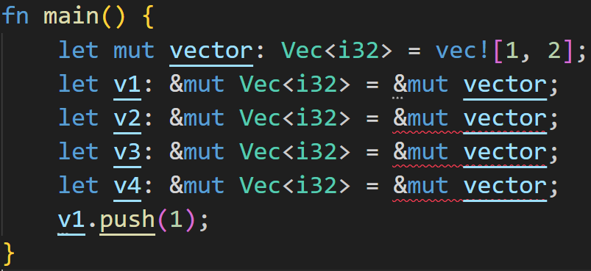
Lifetimes
For a very long time, the following definitions will suffice:
Lifetime for a variable: Usually the code block it is defined in
Lifetime for a borrow: The time between using it for the first* and the last time
Variables can be borrowed in their lifetimes only
©Philippe Felix Haupt 2023

Slide 53
Lifetimes
For a very long time, the following definitions will suffice:
Lifetime for a variable: Usually the code block it is defined in
Lifetime for a borrow: The time between using it for the first* and the last time
Variables can be borrowed in their lifetimes only
lifetime of vector
©Philippe Felix Haupt 2023

Slide 54
Lifetimes
For a very long time, the following definitions will suffice:
Lifetime for a variable: Usually the code block it is defined in
Lifetime for a borrow: The time between using it for the first* and the last time
Variables can be borrowed in their lifetimes only
lifetime of vector
mut v1
©Philippe Felix Haupt 2023

Slide 55
Lifetimes
For a very long time, the following definitions will suffice:
Lifetime for a variable: Usually the code block it is defined in
Lifetime for a borrow: The time between using it for the first* and the last time
Variables can be borrowed in their lifetimes only
mut v2
lifetime of vector
mut v1
mut v3
mut v4
©Philippe Felix Haupt 2023

Slide 56
Lifetimes
For a very long time, the following definitions will suffice:
Lifetime for a variable: Usually the code block it is defined in
Lifetime for a borrow: The time between using it for the first* and the last time
Variables can be borrowed in their lifetimes only
Lifetimes overlap!
mut v2
lifetime of vector
mut v1
mut v3
mut v4
©Philippe Felix Haupt 2023

Slide 57
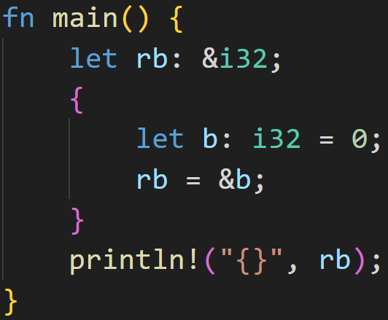
Lifetimes
For a very long time, the following definitions will suffice:
Lifetime for a variable: Usually the code block it is defined in
Lifetime for a borrow: The time between using it for the first* and the last time
Variables can be borrowed in their lifetimes only
©Philippe Felix Haupt 2023

Slide 58
Intermission: Correcting session 02
For a very long time, the following definitions will suffice:
Lifetime for a variable: Usually the code block it is defined in
Lifetime for a borrow: The time between using it for the first* and the last time
Variables can be borrowed in their lifetimes only
Whoops :^) In session 02 I told you that you can’t do that!
©Philippe Felix Haupt 2023

Slide 59
Intermission: Correcting session 02
For a very long time, the following definitions will suffice:
Lifetime for a variable: Usually the code block it is defined in
Lifetime for a borrow: The time between using it for the first* and the last time
Variables can be borrowed in their lifetimes only
Whoops :^) In session 02 I told you that you can’t do that!
Well, you can, as long as you assign something to the variable before using it.
©Philippe Felix Haupt 2023

Slide 60
Intermission: Correcting session 02
For a very long time, the following definitions will suffice:
Lifetime for a variable: Usually the code block it is defined in
Lifetime for a borrow: The time between using it for the first* and the last time
Variables can be borrowed in their lifetimes only
Whoops :^) In session 02 I told you that you can’t do that!
Well, you can, as long as you assign something to the variable before using it.
We assign to rb here.
©Philippe Felix Haupt 2023

Slide 61
Intermission: Correcting session 02
For a very long time, the following definitions will suffice:
Lifetime for a variable: Usually the code block it is defined in
Lifetime for a borrow: The time between using it for the first* and the last time
Variables can be borrowed in their lifetimes only
Whoops :^) In session 02 I told you that you can’t do that!
Well, you can, as long as you assign something to the variable before using it.
We assign to rb here.
We use rb here.
©Philippe Felix Haupt 2023

Slide 62
Intermission: Correcting session 02
For a very long time, the following definitions will suffice:
Lifetime for a variable: Usually the code block it is defined in
Lifetime for a borrow: The time between using it for the first* and the last time
Variables can be borrowed in their lifetimes only
Whoops :^) In session 02 I told you that you can’t do that!
Well, you can, as long as you assign something to the variable before using it.
We assign to rb here.
We use rb here.
Sorry for the confusion :^)
©Philippe Felix Haupt 2023

Slide 63
Lifetimes
For a very long time, the following definitions will suffice:
Lifetime for a variable: Usually the code block it is defined in
Lifetime for a borrow: The time between using it for the first* and the last time
Variables can be borrowed in their lifetimes only
lifetime of rb
©Philippe Felix Haupt 2023

Slide 64
Lifetimes
For a very long time, the following definitions will suffice:
Lifetime for a variable: Usually the code block it is defined in
Lifetime for a borrow: The time between using it for the first* and the last time
Variables can be borrowed in their lifetimes only
lifetime of rb
lifetime of b
©Philippe Felix Haupt 2023

Slide 65
Lifetimes
For a very long time, the following definitions will suffice:
Lifetime for a variable: Usually the code block it is defined in
Lifetime for a borrow: The time between using it for the first* and the last time
Variables can be borrowed in their lifetimes only
lifetime of rb
lifetime of b
→ rb lives longer than b → b dropped at the end of its lifetime → Violates Rule 3, reference would be invalid
©Philippe Felix Haupt 2023

Slide 66
Functions - Basics
©Philippe Felix Haupt 2023

Slide 67
Functions - Basics
Programming languages come with many Control Flow structures
©Philippe Felix Haupt 2023

Slide 68
Functions - Basics
Programming languages come with many Control Flow structures, so far we covered:
if-statements
©Philippe Felix Haupt 2023

Slide 69
Functions - Basics
Programming languages come with many Control Flow structures, so far we covered:
if-statements
loops, break, continue
©Philippe Felix Haupt 2023

Slide 70
Functions - Basics
Programming languages come with many Control Flow structures, so far we covered:
if-statements
loops, break, continue
Functions are yet another way of controlling your code
©Philippe Felix Haupt 2023

Slide 71
Functions - Basics
Programming languages come with many Control Flow structures, so far we covered:
if-statements
loops, break, continue
Functions are yet another way of controlling your code
Functions allow us to isolate pieces of logic, instead of writing one big blob of code
©Philippe Felix Haupt 2023

Slide 72
Functions - Basics
Programming languages come with many Control Flow structures, so far we covered:
if-statements
loops, break, continue
Functions are yet another way of controlling your code
Functions allow us to isolate pieces of logic, instead of writing one big blob of code
Functions can be reused, more so than code inside a loop
©Philippe Felix Haupt 2023

Slide 73
Functions - Basics
Programming languages come with many Control Flow structures, so far we covered:
if-statements
loops, break, continue
Functions are yet another way of controlling your code
Functions allow us to isolate pieces of logic, instead of writing one big blob of code
Functions can be reused, more so than code inside a loop
Functions can take in parameters, and return values
©Philippe Felix Haupt 2023

Slide 74
Functions - Basics
Programming languages come with many Control Flow structures, so far we covered:
if-statements
loops, break, continue
Functions are yet another way of controlling your code
Functions allow us to isolate pieces of logic, instead of writing one big blob of code
Functions can be reused, more so than code inside a loop
Functions can take in parameters, and return values
Functions in Programming are almost identical to mathematical functions:
©Philippe Felix Haupt 2023

Slide 75
Functions - Basics
Programming languages come with many Control Flow structures, so far we covered:
if-statements
loops, break, continue
Functions are yet another way of controlling your code
Functions allow us to isolate pieces of logic, instead of writing one big blob of code
Functions can be reused, more so than code inside a loop
Functions can take in parameters, and return values
Functions in Programming are almost identical to mathematical functions:
Take in some inputs (called parameters)
©Philippe Felix Haupt 2023

Slide 76
Functions - Basics
Programming languages come with many Control Flow structures, so far we covered:
if-statements
loops, break, continue
Functions are yet another way of controlling your code
Functions allow us to isolate pieces of logic, instead of writing one big blob of code
Functions can be reused, more so than code inside a loop
Functions can take in parameters, and return values
Functions in Programming are almost identical to mathematical functions:
Take in some inputs (called parameters)
Do something with those inputs
©Philippe Felix Haupt 2023

Slide 77
Functions - Basics
Programming languages come with many Control Flow structures, so far we covered:
if-statements
loops, break, continue
Functions are yet another way of controlling your code
Functions allow us to isolate pieces of logic, instead of writing one big blob of code
Functions can be reused, more so than code inside a loop
Functions can take in parameters, and return values
Functions in Programming are almost identical to mathematical functions:
Take in some inputs (called parameters)
Do something with those inputs
Return the output (called return value)
©Philippe Felix Haupt 2023

Slide 78
Functions - Basics
Programming languages come with many Control Flow structures, so far we covered:
if-statements
loops, break, continue
Functions are yet another way of controlling your code
Functions allow us to isolate pieces of logic, instead of writing one big blob of code
Functions can be reused, more so than code inside a loop
Functions can take in parameters, and return values
Functions in Programming are almost identical to mathematical functions:
Take in some inputs (called parameters)
Do something with those inputs
Return the output (called return value)
Functions in Rust are declared using the keyword fn, we’ve seen this one a few times already!
©Philippe Felix Haupt 2023

Slide 79
Functions - Basics
Programming languages come with many Control Flow structures, so far we covered:
if-statements
loops, break, continue
Functions are yet another way of controlling your code
Functions allow us to isolate pieces of logic, instead of writing one big blob of code
Functions can be reused, more so than code inside a loop
Functions can take in parameters, and return values
Functions in Programming are almost identical to mathematical functions:
Take in some inputs (called parameters)
Do something with those inputs
Return the output (called return value)
Functions in Rust are declared using the keyword fn, we’ve seen this one a few times already!
The main function, which is the entrypoint of the program, always needs to be defined
©Philippe Felix Haupt 2023

Slide 80
Functions - Components
A function may look like this:
©Philippe Felix Haupt 2023

Slide 81
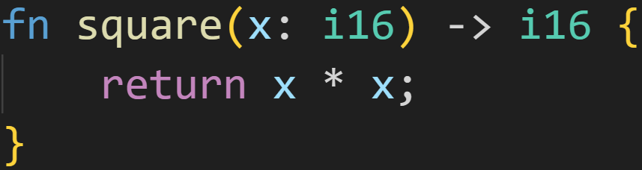
Functions - Components
A function may look like this:
©Philippe Felix Haupt 2023

Slide 82
Functions - Components
A function may look like this:
Parameters
©Philippe Felix Haupt 2023

Slide 83
Functions - Components
A function may look like this:
Parameters
Return Type
©Philippe Felix Haupt 2023

Slide 84
Functions - Components
A function may look like this:
Parameters
Return Type
function body
©Philippe Felix Haupt 2023

Slide 85
Functions - Components
A function may look like this:
Parameters
Return Type
function body
return statement
©Philippe Felix Haupt 2023

Slide 86
Functions - Components
Function name
Parameters
Return Type
function body
return statement
©Philippe Felix Haupt 2023

Slide 87
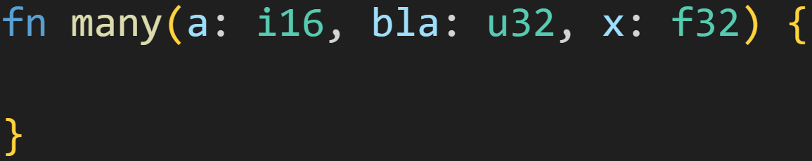
Functions - Components
Parameters are comma-separated entries of name-type pairs
©Philippe Felix Haupt 2023

Slide 88
Functions - Components
Parameters are comma-separated entries of name-type pairs
Parameter `a`
Parameter `bla`
Parameter `x`
©Philippe Felix Haupt 2023

Slide 89
Functions - Components
Parameters are comma-separated entries of name-type pairs
Parameters can be used like normal variables, as in:
©Philippe Felix Haupt 2023

Slide 90
Functions - Components
Parameters are comma-separated entries of name-type pairs
Parameters can be used like normal variables, as in:
They’re immutable by default, you need to add `mut` if you want to modify them
©Philippe Felix Haupt 2023

Slide 91
Functions - Components
Parameters are comma-separated entries of name-type pairs
Parameters can be used like normal variables, as in:
They’re immutable by default, you need to add `mut` if you want to modify them
They’re freed at the end of the function
©Philippe Felix Haupt 2023

Slide 92
Functions - Components
Parameters are comma-separated entries of name-type pairs
Parameters can be used like normal variables, as in:
They’re immutable by default, you need to add `mut` if you want to modify them
They’re freed at the end of the function
Variable shadowing still applies
©Philippe Felix Haupt 2023

Slide 93
Functions - Components
Parameters are comma-separated entries of name-type pairs
Parameters can be used like normal variables, as in:
They’re immutable by default, you need to add `mut` if you want to modify them
They’re freed at the end of the function
Variable shadowing still applies
Borrow Checking still applies, if one parameter is a reference
©Philippe Felix Haupt 2023

Slide 94
Functions - Components
Parameters are comma-separated entries of name-type pairs
Parameters can be used like normal variables, as in:
They’re immutable by default, you need to add `mut` if you want to modify them
They’re freed at the end of the function
Variable shadowing still applies
Borrow Checking still applies, if one parameter is a reference
Ownership-Model still applies, if one parameter can’t be copied
©Philippe Felix Haupt 2023

Slide 95
Functions - Components
Parameters are comma-separated entries of name-type pairs
Parameters can be used like normal variables, as in:
They’re immutable by default, you need to add `mut` if you want to modify them
They’re freed at the end of the function
Variable shadowing still applies
Borrow Checking still applies, if one parameter is a reference
Ownership-Model still applies, if one parameter can’t be copied
You don’t need to define parameters, many functions don’t need them (like main)
©Philippe Felix Haupt 2023

Slide 96
Functions - Components
Parameters are comma-separated entries of name-type pairs
Parameters can be used like normal variables, as in:
They’re immutable by default, you need to add `mut` if you want to modify them
They’re freed at the end of the function
Variable shadowing still applies
Borrow Checking still applies, if one parameter is a reference
Ownership-Model still applies, if one parameter can’t be copied
You don’t need to define parameters, many functions don’t need them (like main)
Parameters define how you’re calling the function later
©Philippe Felix Haupt 2023

Slide 97
Intermission: Floating Point
Integers are good, they’re perfect for your computer, but they have their limits
©Philippe Felix Haupt 2023

Slide 98
Intermission: Floating Point
Integers are good, they’re perfect for your computer, but they have their limits:
They’re only whole numbers
They’re not big numbers
©Philippe Felix Haupt 2023

Slide 99
Intermission: Floating Point
Integers are good, they’re perfect for your computer, but they have their limits:
They’re only whole numbers
They’re not big numbers
Languages such as Rust also offer a data type for those situations:
Float, f32 in Rust
Double, f64 in Rust
©Philippe Felix Haupt 2023

Slide 100
Intermission: Floating Point
Integers are good, they’re perfect for your computer, but they have their limits:
They’re only whole numbers
They’re not big numbers
Languages such as Rust also offer a data type for those situations:
Float, f32 in Rust
Double, f64 in Rust
Floating Point numbers are defined as scientific notation in base 2:
©Philippe Felix Haupt 2023

Slide 101
Intermission: Floating Point
Integers are good, they’re perfect for your computer, but they have their limits:
They’re only whole numbers
They’re not big numbers
Languages such as Rust also offer a data type for those situations:
Float, f32 in Rust
Double, f64 in Rust
Floating Point numbers are defined as scientific notation in base 2:
Scientific notation: 5.4e7 = 5.4x10^7 = 54.000.000
©Philippe Felix Haupt 2023

Slide 102
Intermission: Floating Point
Integers are good, they’re perfect for your computer, but they have their limits:
They’re only whole numbers
They’re not big numbers
Languages such as Rust also offer a data type for those situations:
Float, f32 in Rust
Double, f64 in Rust
Floating Point numbers are defined as scientific notation in base 2:
Scientific notation: 5.4e7 = 5.4x10^7 = 54.000.000
Numbers in that notation are made of two numbers:
Mantissa (the thing before the `e`, here 5.4)
Exponent (the thing after the `e`, here 7)
©Philippe Felix Haupt 2023

Slide 103
Intermission: Floating Point
Integers are good, they’re perfect for your computer, but they have their limits:
They’re only whole numbers
They’re not big numbers
Languages such as Rust also offer a data type for those situations:
Float, f32 in Rust
Double, f64 in Rust
Floating Point numbers are defined as scientific notation in base 2:
Scientific notation: 5.4e7 = 5.4x10^7 = 54.000.000
Numbers in that notation are made of two numbers:
Mantissa (the thing before the `e`, here 5.4)
Exponent (the thing after the `e`, here 7)
Floating Point numbers get a few bits for the mantissa, and a few for the exponent
f32: 23 bits for mantissa, 8 bits for exponent, 1 bit for the sign (+-)
f64: 52 bits for mantissa, 11 bits for exponent, 1 bit for the sign (+-)
©Philippe Felix Haupt 2023

Slide 104
Intermission: Floating Point
Float, f32 in Rust
Double, f64 in Rust
Floating Point numbers are defined as scientific notation in base 2
This way, Floating Points can represent fractions
f32 can represent 7 or 8 decimal digits
f64 can represent 15 or 16 decimal digits
This way, Floating Points can represent big numbers
f32 can represent 3.4x10^38 ← 38 zeroes! You’d need u128 to represent that :^)
f64 can represent 1.8x10^308 ← 308 zeroes! You’d need u1024 to represent that :^)
©Philippe Felix Haupt 2023

Slide 105
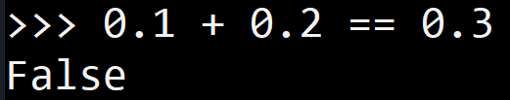
Intermission: Floating Point
Float, f32 in Rust
Double, f64 in Rust
Floating Point numbers are defined as scientific notation in base 2
This way, Floating Points can represent fractions
f32 can represent 7 or 8 decimal digits
f64 can represent 15 or 16 decimal digits
This way, Floating Points can represent big numbers
f32 can represent 3.4x10^38 ← 38 zeroes! You’d need u128 to represent that :^)
f64 can represent 1.8x10^308 ← 308 zeroes! You’d need u1024 to represent that :^)
There’s a problem - Limited precision:
If you can only use 7 decimal digits at all times to represent the mantissa, after some time you start to skip numbers:
5.4000001e12 + 1 == 5.4000001e12 :^)
Even further, we’re using base 2, so we can’t even do math properly:
0.1 + 0.2 != 0.3 :^)
©Philippe Felix Haupt 2023

Slide 106
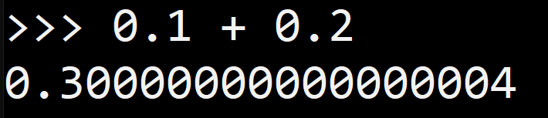
Intermission: Floating Point
Float, f32 in Rust
Double, f64 in Rust
Floating Point numbers are defined as scientific notation in base 2
This way, Floating Points can represent fractions
f32 can represent 7 or 8 decimal digits
f64 can represent 15 or 16 decimal digits
This way, Floating Points can represent big numbers
f32 can represent 3.4x10^38 ← 38 zeroes! You’d need u128 to represent that :^)
f64 can represent 1.8x10^308 ← 308 zeroes! You’d need u1024 to represent that :^)
There’s a problem - Limited precision:
If you can only use 7 decimal digits at all times to represent the mantissa, after some time you start to skip numbers:
5.4000001e12 + 1 == 5.4000001e12 :^)
Even further, we’re using base 2, so we can’t even do math properly:
0.1 + 0.2 != 0.3 :^)
©Philippe Felix Haupt 2023

Slide 107
Intermission: Floating Point
Float, f32 in Rust
Double, f64 in Rust
Floating Point numbers in Rust are always specified with a decimal:
©Philippe Felix Haupt 2023

Slide 108
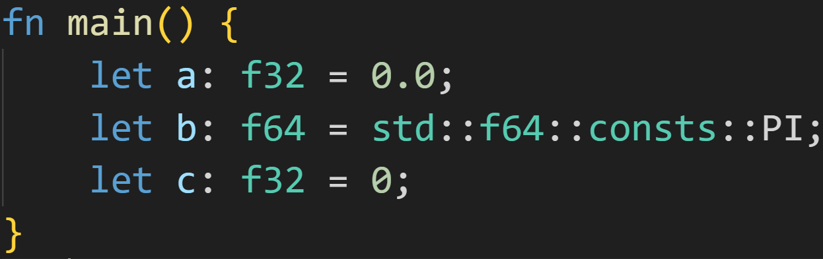
Intermission: Floating Point
Float, f32 in Rust
Double, f64 in Rust
Floating Point numbers in Rust are always specified with a decimal:
©Philippe Felix Haupt 2023

Slide 109
Intermission: Floating Point
Float, f32 in Rust
Double, f64 in Rust
Floating Point numbers in Rust are always specified with a decimal:
Valid Float literal
©Philippe Felix Haupt 2023

Slide 110
Intermission: Floating Point
Float, f32 in Rust
Double, f64 in Rust
Floating Point numbers in Rust are always specified with a decimal:
Valid Float literal
Useful constants are defined here
©Philippe Felix Haupt 2023

Slide 111
Intermission: Floating Point
Float, f32 in Rust
Double, f64 in Rust
Floating Point numbers in Rust are always specified with a decimal:
Valid Float literal
Useful constants are defined here
Bad! `0` is an Integer literal, but Rust expects a Float literal here! Throws compiler error!
©Philippe Felix Haupt 2023

Slide 112
Intermission: Floating Point
Float, f32 in Rust
Double, f64 in Rust
Floating Point numbers in Rust are always specified with a decimal
Floating Points are whack:
NaN
Positive Infinity
Negative Infinity
+0.0
-0.0
0.1 + 0.2 != 0.3
a + (b + c) != (a + b) + c ← not associative!
©Philippe Felix Haupt 2023

Slide 113
Intermission: Floating Point
Float, f32 in Rust
Double, f64 in Rust
Floating Point numbers in Rust are always specified with a decimal
Floating Points are whack:
NaN
Positive Infinity
Negative Infinity
+0.0
-0.0
0.1 + 0.2 != 0.3
a + (b + c) != (a + b) + c ← not associative!
But they’re still useful in a lot of cases, so we’ll slowly begin using them :)
©Philippe Felix Haupt 2023

Slide 114
Functions - Components
Not every function returns a value, some just do stuff with the inputs
©Philippe Felix Haupt 2023

Slide 115
Functions - Components
Not every function returns a value, some just do stuff with the inputs
It might just write to a file, or print in the console
©Philippe Felix Haupt 2023

Slide 116
Functions - Components
Not every function returns a value, some just do stuff with the inputs
It might just write to a file, or print in the console
The return type is optional, and declared using the Arrow syntax
©Philippe Felix Haupt 2023

Slide 117
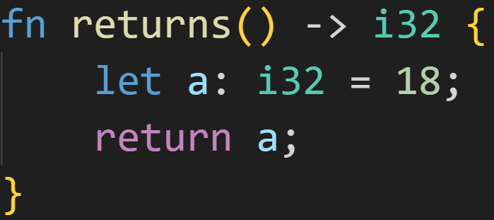
Functions - Components
Not every function returns a value, some just do stuff with the inputs
It might just write to a file, or print in the console
The return type is optional, and declared using the Arrow syntax
©Philippe Felix Haupt 2023

Slide 118
Functions - Components
Not every function returns a value, some just do stuff with the inputs
It might just write to a file, or print in the console
The return type is optional, and declared using the Arrow syntax
If a return type is specified, all return statements in the function need to return a value
©Philippe Felix Haupt 2023

Slide 119
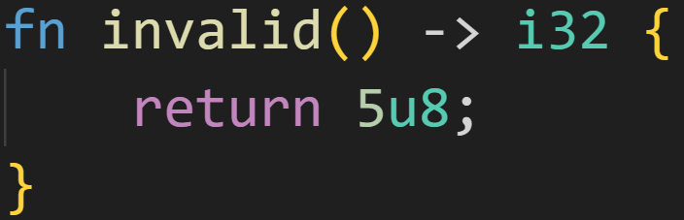
Functions - Components
Not every function returns a value, some just do stuff with the inputs
It might just write to a file, or print in the console
The return type is optional, and declared using the Arrow syntax
If a return type is specified, all return statements in the function need to return a value
Those values need to have the same type as the return type
©Philippe Felix Haupt 2023

Slide 120
Functions - Components
Not every function returns a value, some just do stuff with the inputs
It might just write to a file, or print in the console
The return type is optional, and declared using the Arrow syntax
If a return type is specified, all return statements in the function need to return a value
Those values need to have the same type as the return type
If a return type is specified, all possible paths through the function need to end in a return
©Philippe Felix Haupt 2023

Slide 121
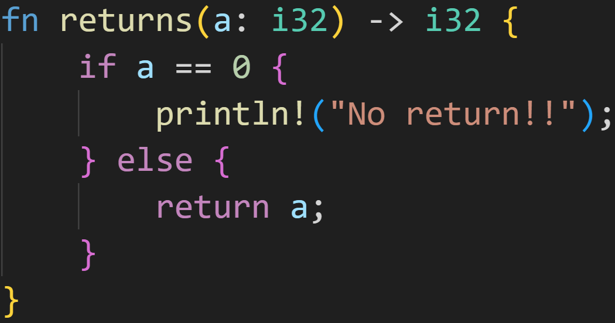
Functions - Components
Not every function returns a value, some just do stuff with the inputs
It might just write to a file, or print in the console
The return type is optional, and declared using the Arrow syntax
If a return type is specified, all return statements in the function need to return a value
If a return type is specified, all possible paths through the function need to end in a return
©Philippe Felix Haupt 2023

Slide 122
Functions - Components
Not every function returns a value, some just do stuff with the inputs
It might just write to a file, or print in the console
The return type is optional, and declared using the Arrow syntax
If a return type is specified, all return statements in the function need to return a value
If a return type is specified, all possible paths through the function need to end in a return
No return statement! Compiler error!
©Philippe Felix Haupt 2023

Slide 123
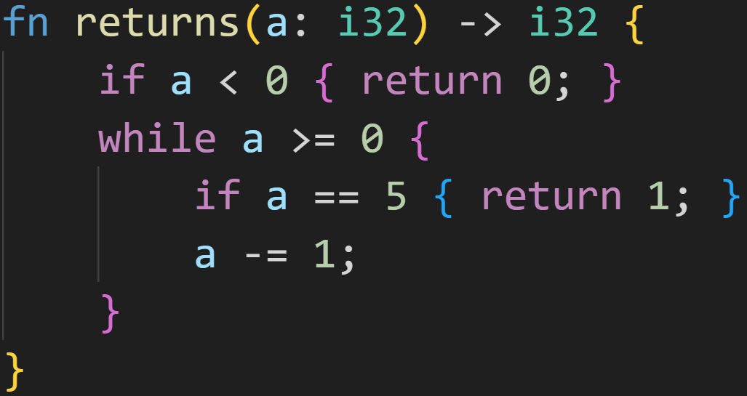
Functions - Components
1/3
Not every function returns a value, some just do stuff with the inputs
It might just write to a file, or print in the console
The return type is optional, and declared using the Arrow syntax
If a return type is specified, all return statements in the function need to return a value
If a return type is specified, all possible paths through the function need to end in a return
©Philippe Felix Haupt 2023

Slide 124
Functions - Components
1/3
Not every function returns a value, some just do stuff with the inputs
It might just write to a file, or print in the console
The return type is optional, and declared using the Arrow syntax
If a return type is specified, all return statements in the function need to return a value
If a return type is specified, all possible paths through the function need to end in a return
Do all possible paths lead to a return?
©Philippe Felix Haupt 2023

Slide 125
Functions - Components
1/3
Not every function returns a value, some just do stuff with the inputs
It might just write to a file, or print in the console
The return type is optional, and declared using the Arrow syntax
If a return type is specified, all return statements in the function need to return a value
If a return type is specified, all possible paths through the function need to end in a return
Do all possible paths lead to a return?
Nope. Imagine `a` was 4 in the beginning.
The while-loop only returns if `a` is 5, so it’ll fall straight through, and get to the end of the function. But there is no return statement there!
©Philippe Felix Haupt 2023

Slide 126
Functions - Components
1/3
Not every function returns a value, some just do stuff with the inputs
It might just write to a file, or print in the console
The return type is optional, and declared using the Arrow syntax
If a return type is specified, all return statements in the function need to return a value
If a return type is specified, all possible paths through the function need to end in a return
`a` isn’t even marked as mutable!
©Philippe Felix Haupt 2023

Slide 127
Functions - Components
Not every function returns a value, some just do stuff with the inputs
It might just write to a file, or print in the console
The return type is optional, and declared using the Arrow syntax
If a return type is specified, all return statements in the function need to return a value
Those values need to have the same type as the return type
If a return type is specified, all possible paths through the function need to end in a return
This is checked by the compiler
©Philippe Felix Haupt 2023

Slide 128
Functions - Components
Not every function returns a value, some just do stuff with the inputs
It might just write to a file, or print in the console
The return type is optional, and declared using the Arrow syntax
If a return type is specified, all return statements in the function need to return a value
Those values need to have the same type as the return type
If a return type is specified, all possible paths through the function need to end in a return
This is checked by the compiler
If no return type is specified, only empty return statements are allowed
©Philippe Felix Haupt 2023

Slide 129
Functions - Components
Not every function returns a value, some just do stuff with the inputs
It might just write to a file, or print in the console
The return type is optional, and declared using the Arrow syntax
If a return type is specified, all return statements in the function need to return a value
Those values need to have the same type as the return type
If a return type is specified, all possible paths through the function need to end in a return
This is checked by the compiler
If no return type is specified, only empty return statements are allowed
If no return type is specified, not all paths need to end in a return
There’s an implicit return statement at the end of every function
©Philippe Felix Haupt 2023

Slide 130
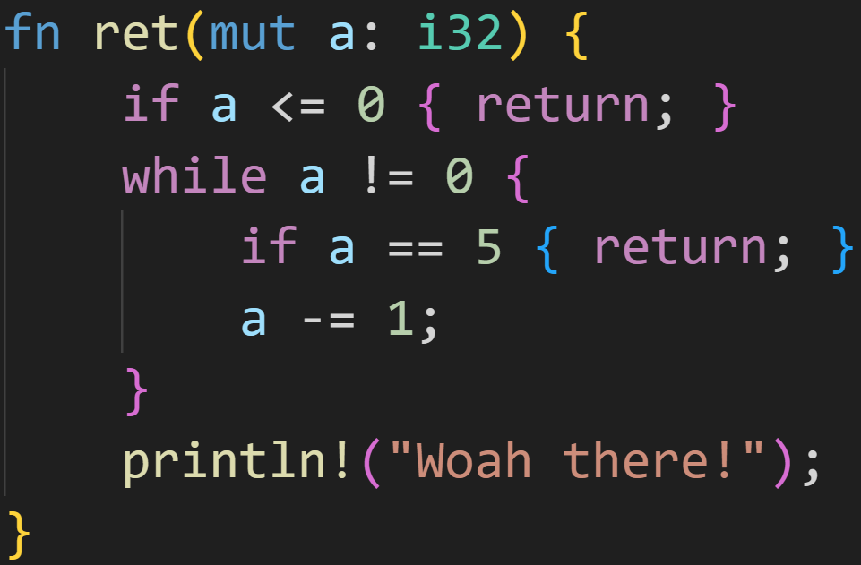
Functions - Components
©Philippe Felix Haupt 2023

Slide 131
Functions - Components
no return type
©Philippe Felix Haupt 2023

Slide 132
Functions - Components
no return type
empty return statements
©Philippe Felix Haupt 2023

Slide 133
Functions - Components
no return type
empty return statements
implicit return
©Philippe Felix Haupt 2023

Slide 134
Intermission: Exercise
Time for exercises!
©Philippe Felix Haupt 2023

Slide 135
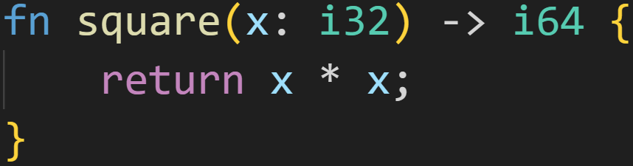
Intermission: Exercise
Time for exercises!
1/3
©Philippe Felix Haupt 2023

Slide 136
Intermission: Exercise
Time for exercises!
Is this a valid function definition?
1/3
©Philippe Felix Haupt 2023

Slide 137
Intermission: Exercise
Time for exercises!
Is this a valid function definition?
1/3
Expected to return i64
©Philippe Felix Haupt 2023

Slide 138
Intermission: Exercise
Time for exercises!
Is this a valid function definition?
1/3
Expected to return i64
expression has type i32*i32=i32
©Philippe Felix Haupt 2023

Slide 139
Intermission: Exercise
Time for exercises!
Is this a valid function definition?
1/3
Expected to return i64
expression has type i32*i32=i32
Does not work!
©Philippe Felix Haupt 2023

Slide 140
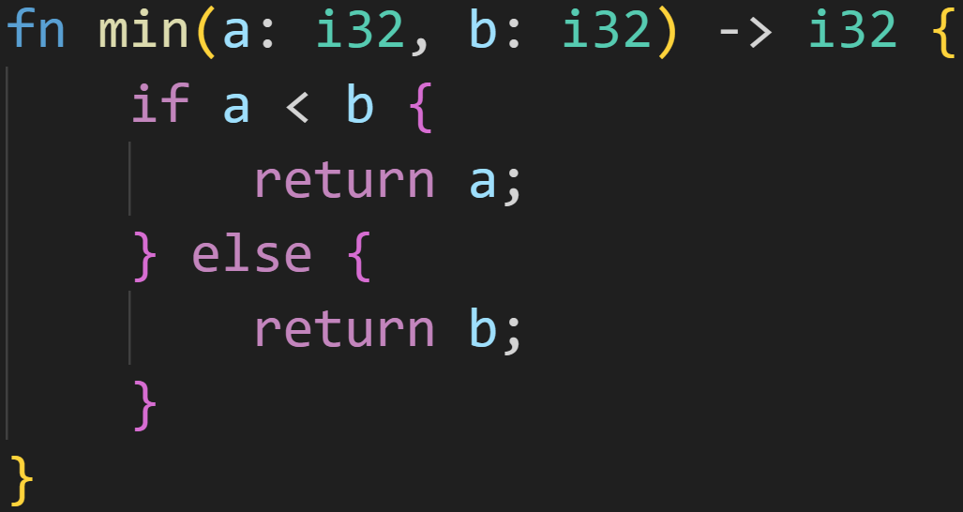
Intermission: Exercise
1/3
Time for exercises!
©Philippe Felix Haupt 2023

Slide 141
Intermission: Exercise
Is this a valid function definition?
1/3
Time for exercises!
©Philippe Felix Haupt 2023

Slide 142
Intermission: Exercise
Is this a valid function definition?
1/3
Time for exercises!
Yes!
→ All return statements return i32
→ All paths lead to a return statement
©Philippe Felix Haupt 2023

Slide 143
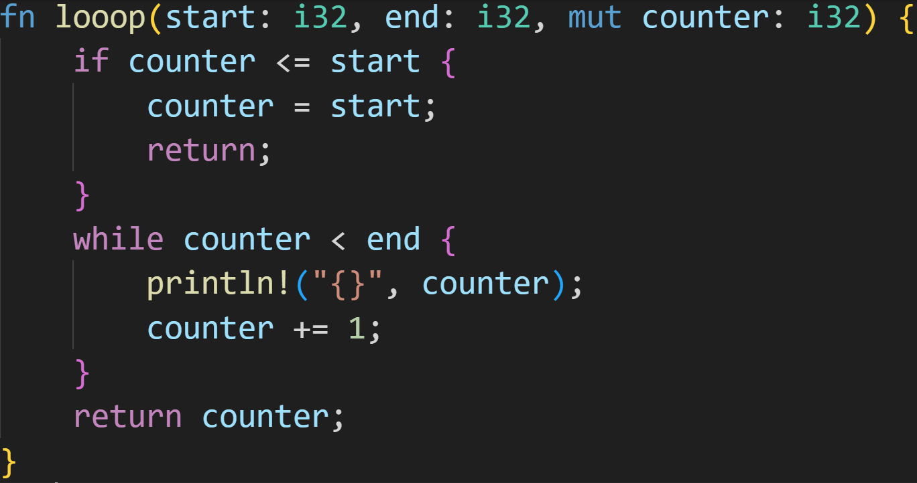
Intermission: Exercise
2/3
Time for exercises!
©Philippe Felix Haupt 2023

Slide 144
Intermission: Exercise
Is this a valid function definition?
2/3
Time for exercises!
©Philippe Felix Haupt 2023

Slide 145
Intermission: Exercise
Is this a valid function definition?
2/3
Time for exercises!
No!
Last line: Function is not declared to return anything! Yet, we’re attempting to return i32.
©Philippe Felix Haupt 2023

Slide 146
Intermission: Exercise
Is this a valid function definition?
2/3
Time for exercises!
Does declaring the return type as i32 fix it?
©Philippe Felix Haupt 2023

Slide 147
Intermission: Exercise
Is this a valid function definition?
2/3
Time for exercises!
Does declaring the return type as i32 fix it?
Also no! We’re returning nothing in that if-branch :)
©Philippe Felix Haupt 2023

Slide 148
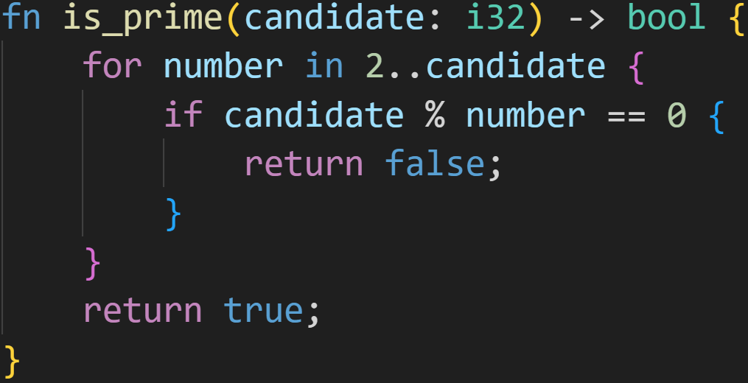
Intermission: Exercise
3/3
Time for exercises!
©Philippe Felix Haupt 2023

Slide 149
Intermission: Exercise
Is this function correct?
3/3
Time for exercises!
©Philippe Felix Haupt 2023

Slide 150
Intermission: Exercise
Is this function correct?
3/3
Time for exercises!
The algorithm itself is correct, it correctly tells us it’s not a prime if any number divides into it.
©Philippe Felix Haupt 2023

Slide 151
Intermission: Exercise
Is this function correct?
3/3
Time for exercises!
The algorithm itself is correct, it correctly tells us it’s not a prime if any number divides into it.
BUT! It returns true for negative numbers, 0 and 1! :)
Those are not prime numbers :(
©Philippe Felix Haupt 2023

Slide 152
Intermission: Exercise
3/3
Time for exercises!
The algorithm itself is correct, it correctly tells us it’s not a prime if any number divides into it.
BUT! It returns true for negative numbers, 0 and 1! :)
Those are not prime numbers :(
How do we fix that?
©Philippe Felix Haupt 2023

Slide 153
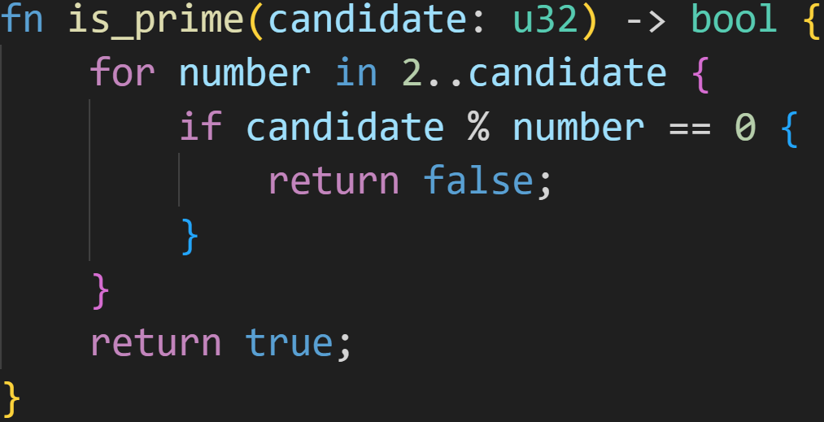
Intermission: Exercise
Step 1: Prevent negative numbers!
3/3
Time for exercises!
©Philippe Felix Haupt 2023

Slide 154
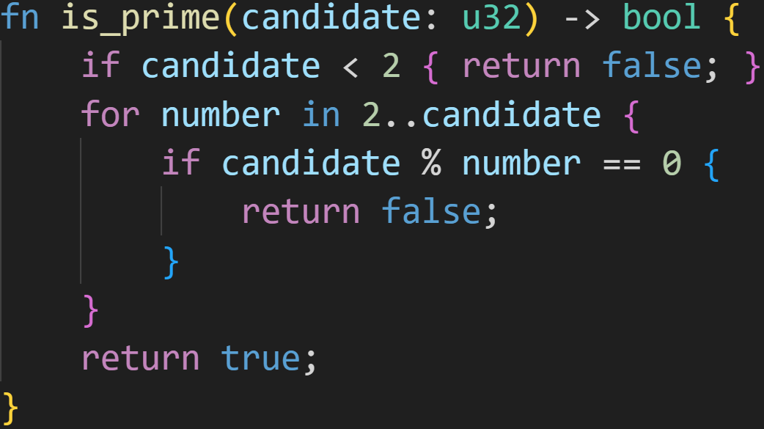
Intermission: Exercise
Step 1: Prevent negative numbers!
3/3
Time for exercises!
Step 2: 0 and 1 are not prime!
©Philippe Felix Haupt 2023

Slide 155
Intermission: Exercise
Is this now a correct function?
3/3
Time for exercises!
©Philippe Felix Haupt 2023

Slide 156
Intermission: Exercise
Is this now a correct function?
3/3
Time for exercises!
Yes :)
©Philippe Felix Haupt 2023

Slide 157
Next time
Using functions
References as parameters
©Philippe Felix Haupt 2023

